Slide 1
Linear Circuit Analysis II
EECE 202

Slide 2
Why do we need Linear Circuit Analysis ?
There are many challenges that the world is facing to ensure sustainable and enhanced quality of life in the following industries:
Transportation
Energy
Communication
Medicine
Housing
Other (any suggestions)?

Slide 3
Why do we need Linear Circuit Analysis ?
Linear Circuit Analysis is required for creating electrical and electronic solutions to these challenges!
For example…..

Slide 4
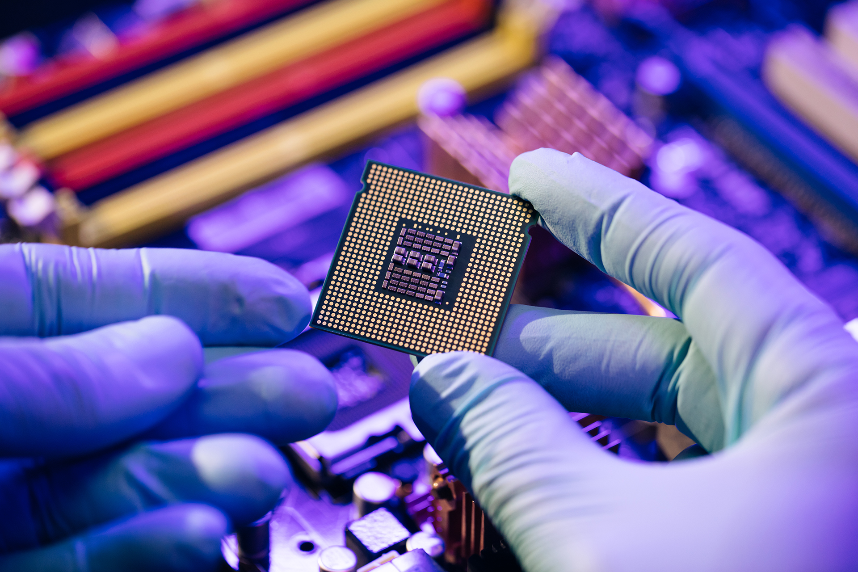


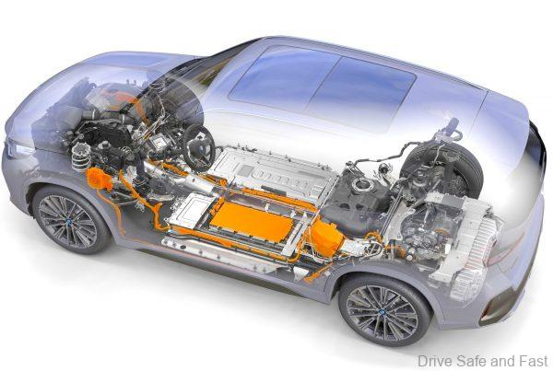
Transportation
Energy: Photovoltaic Materials
Power Semiconductors
and energy storage
technology – Plug-in
Hybrid Electric Vehicles
Renewable Energy –
Solar Power from Photovoltaic Materials
Wind Power from Generators

Slide 5

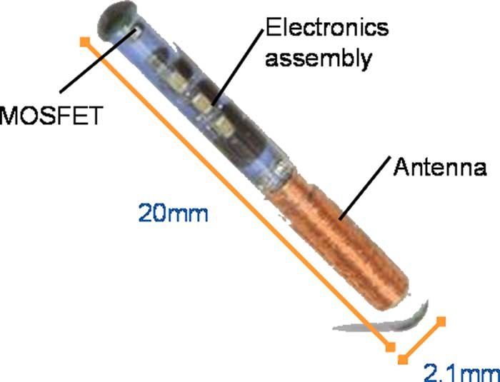

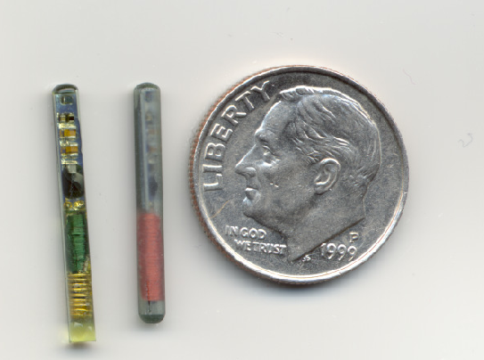
Communication
Medical Technologies
Implantable radiation
sensors to improve
cancer therapy
Electromagnetic imaging
Integrated Circuits and
RF/Microwave Electronics
Apple - Samsung

Slide 6
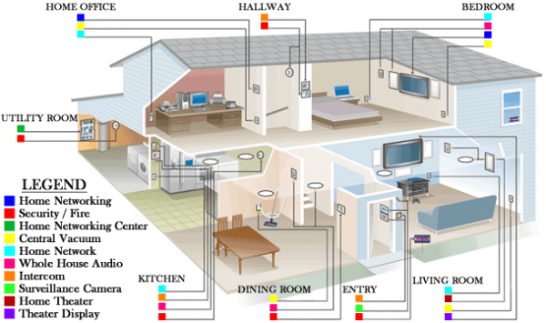
Housing
Electronic Systems:
energy management
Telecommunications
security
entertainment

